Slide 1
Tableau Case Study

Slide 2
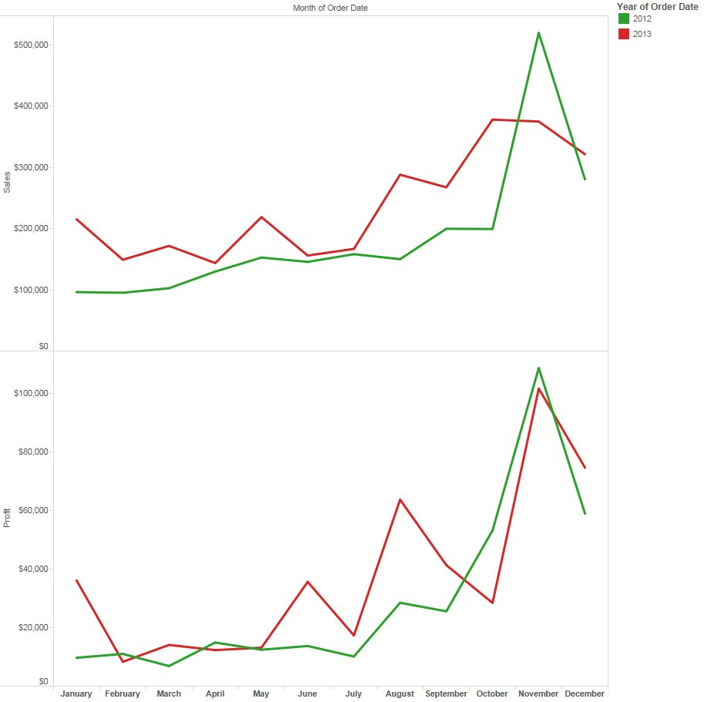
The CFO of an electronics chain is interested in gaining a better understanding of sales and profits. She has a very specific question of the data:
"What do monthly sales and profits look like over the past two years?"
She would like this information on one page for her monthly team reviews so she can hand it out without wasting too much paper. Additionally, she wants to easily contrast the current year with the prior year.

Slide 3
The CFO has learned that, due to an error in the business rules being applied on the data, shipping costs are being subtracted from the profit twice. There is a key meeting later today to present company performance and no time to fix the error at the data level:

Slide 4
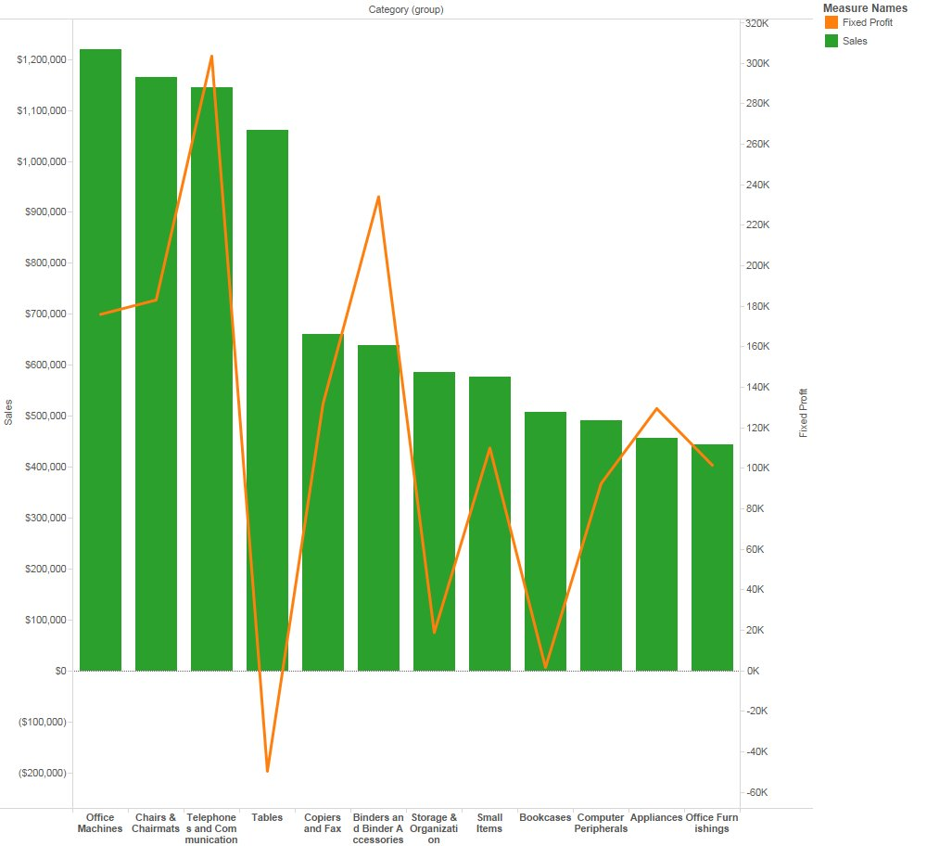
Management has a new request: "Can you show us, on the same chart, both profits and sales by product sub-category in descending order of profit?"
Bonus: Can you think of a way to focus management on the key product categories and not all of the many small items that the company sells?

Slide 5
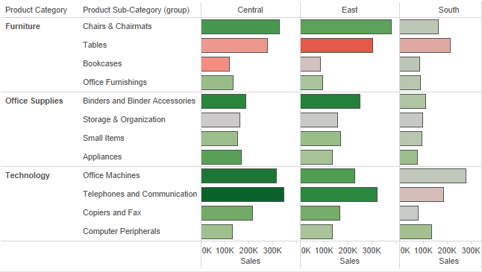
The regional sales managers of Superstore are interested in an analysis of sales and profit by product category, sub-category and region. They will use this information to discuss growth opportunities for new products and possible pricing changes or product cancellation ideas.
They want to know: "What do our sales and profits look like by product category, sub-category and region? Also, can you give us the ability to drill from category to sub-category to the individual item that was purchased?"

Slide 6
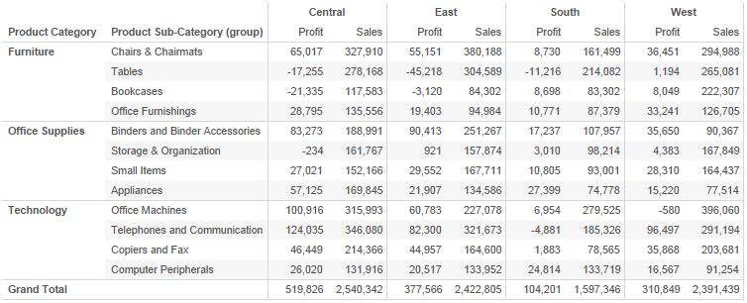
The Sales Manager for the East Region doesn't want to see a viz of profit and sales by product category and sub-category.
"The bar chart is awesome, but can you show me a cross-tab of the data? I need to see actual values!"

Slide 7
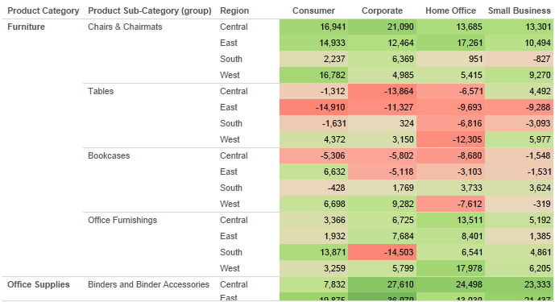
After the regional sales managers reviewed your analsis of Profit by product category, the West sales manager called and asked for more details.
His question: "I like the crosstab, but I also need to quickly see where my best and worst performers are. Can you build me a view highlighting profits by customer segment, product category, sub-category and region?"

Slide 8
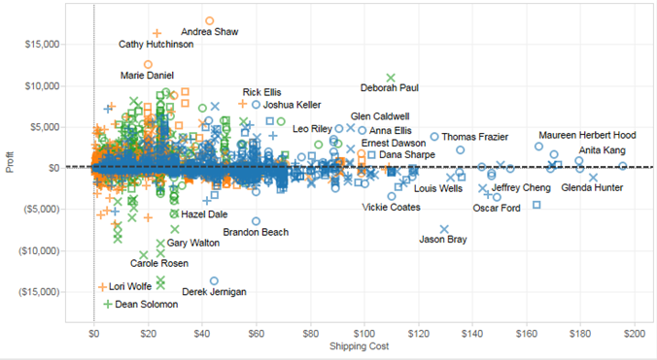
Now that the state level managers understand sales and profits geographically, you've been tasked with analyzing unprofitable product categories. The questions that need answers are:
"Why are certain categories unprofitable? Maybe shipping costs, or the cost of goods sold having an affect?
Are there any trends when you look at the numbers by container, product category or region?"

Slide 9
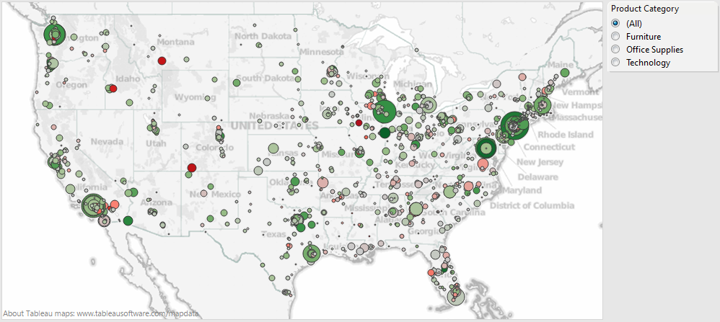
After the regional sales manager reviewed your analysis of profit by customer segment, they scheduled a follow-up meeting and asked for additional analysis.
"Can you create a geographic map to distribute to the state managers that shows profits and sales down to the city level? We also need the ability to choose the Product Category that is displayed."

Slide 10
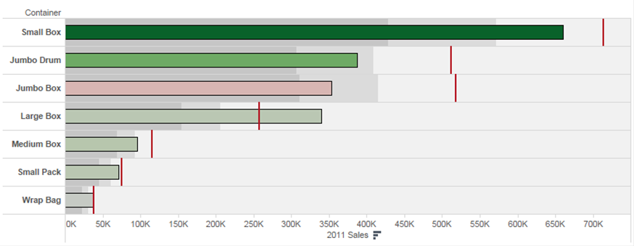
Your VP of sales wants to make some sales comparisons and needs your help.
"Can you show me how 2011 sales compare to 2012 sales across containers?
I would also like to see profitability across the containers."

Slide 11
The VP of sales loved the bullet chart once he was taught how to read it.
"I love the quick insight gleaned from this chart! Very nice!! Can we take it a step further? I'd like myself and the other VP's to have the ability to select a dimension and view values on the bullet chart. Possible?"

